Slide 1
Crypto Price Tracker
By:
Group 8
02_Shubham Arutwar
27_Zeeshan Ansari
52_Kanchan Mengune
73_Prajwal Ruke
Under The Guidance Of :
Prof. Shatabdi M. Bhalerao

Slide 2
Index
Introduction
Objectives
Design Details
Flowchart
External Libraries
API – CoinGecko
Result
Conclusion

Slide 3
Introduction:
Cryptocurrency nowadays is in most demand and many people are investing in these currencies to get high returns.
Many websites and applications provide us information about the rates of different cryptocurrencies available in the Crypto Market.
We will be building a simple application in which we will be displaying the rates of different cryptocurrencies.

Slide 4
Objectives:
1. To inform user about current price of the crypto currency in INR.
2. To provide price chart of that crypto currency of past 7 days for better understanding of market conditions.
3. Making monitoring multiple crypto currencies at once easy.
4. To make the application’s UI user friendly and appealing to use.

Slide 5
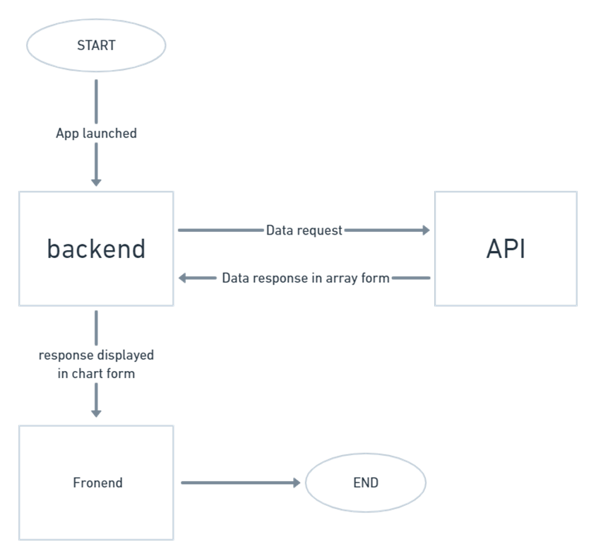
Flowchart:

Slide 6
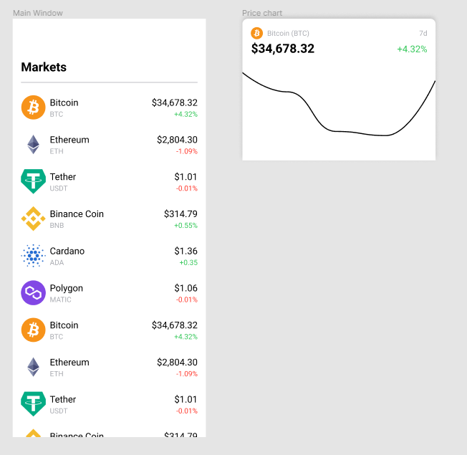

Design Details:
Figma is a vector graphics editor and primarily web-based prototyping tool.
Figma is a powerful design tool that helps you to create prototype of websites, applications, logos.

Slide 7
System specifications:
HARDWARE REQUIREMENTS
RAM: 4 GB
Storage: 16 GB
Processor: any ARM based dual core processor or above
SOFTWARE REQUIREMENTS
Android 9 or above Operating System
Expo Go application

Slide 8
External Libraries:
Flatlist - Extended version of react native flat list with many built in function such as search, pull to refresh, no data available message if empty row
Bottom sheet - Overlay Modal that displays content from the bottom of the screen.
React native animated charts - The main assumptions of the library were to create smooth transitions between subsequent data sets.
Axios - Axios is a JavaScript library used to make HTTP requests and it supports the Promise API that is native to JS. You can make any HTTP calls using Axios in React Native. Axios provides you the facility to call GET, POST, PUT, PATCH, and DELETE requests.

Slide 9
API - CoinGecko
The CoinGecko API provides fundamental analysis of the digital currency market and allows us to retrieve cryptocurrency data such as price, volume, market cap, and exchange data using code.
It have open source code where you can see the working of the API.
Its verry reliable with verry low downtime.

Slide 10
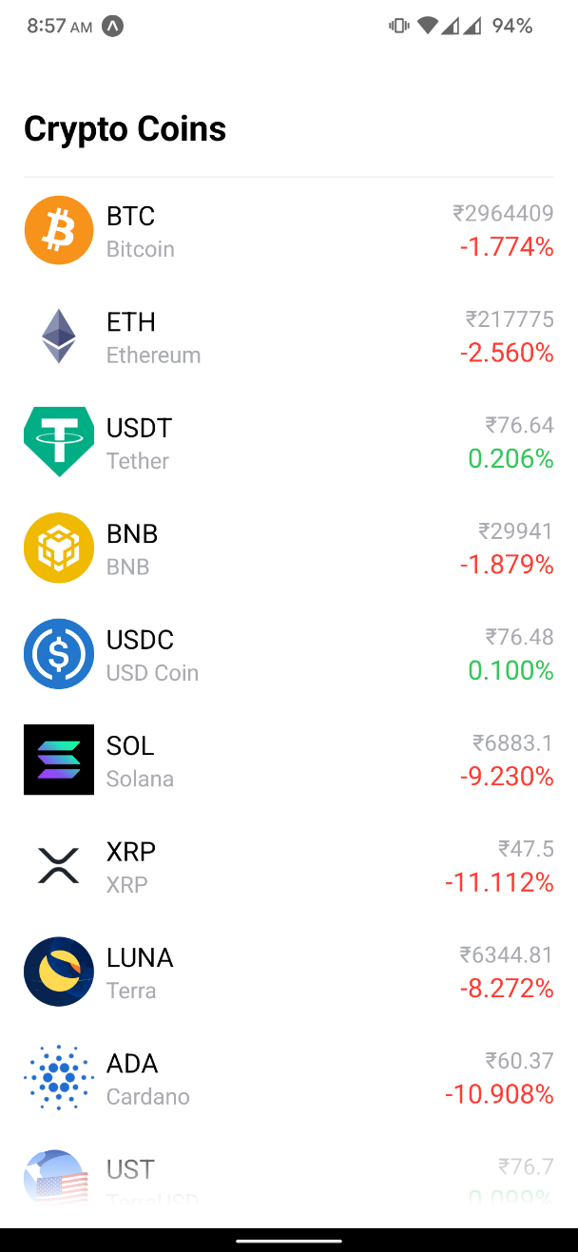
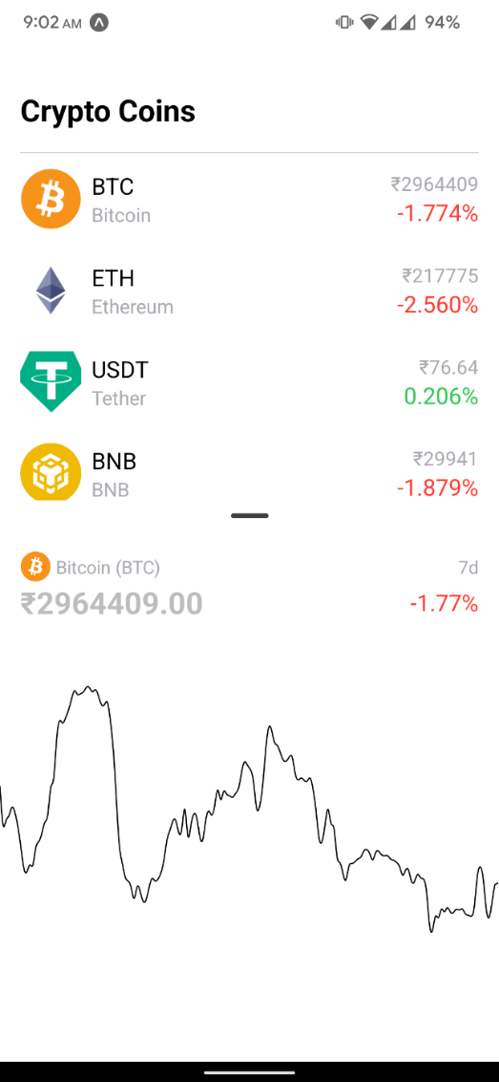
Result:

Slide 11
Conclusion:
In Conclusion we created the CryptoPrice Tracker with live price monitoring and the charts for price monitoring.
Updating and maintenance of this application is really easy as it works with a reliable API.
This project has many future implementations such as adding variable market charts where user can choose between 1d, 7d, 30d charts of the selected cryptocurrency.
Also, the we can add different sections for different blockchain based technologies like NFT’s and its price monitoring.
We can also include some sections where users can chat and discus about different cryptocurrencies and current market conditions to form a community.

Slide 12
References:
1 - React Native Documentation:
https://reactnative.dev/
2 - forums to get help with problems and fixing bugs:
https://stackoverflow.com/
3 - CoinGecko API Documentation:
https://www.coingecko.com/en/api/documentation
4 – Documentation of External libraries:
https://www.npmjs.com/package/react-native-axios
https://www.npmjs.com/package/react-native-complete-flatlist
https://www.npmjs.com/package/react-spring-bottom-sheet
https://github.com/rainbow-me/react-native-animated-charts

Slide 13
Thank You

